Slide 1
Using R Notebook
A Guide to Organizing and Presenting Data for an Aesthetic Delivery Using R Notebooks

Slide 2
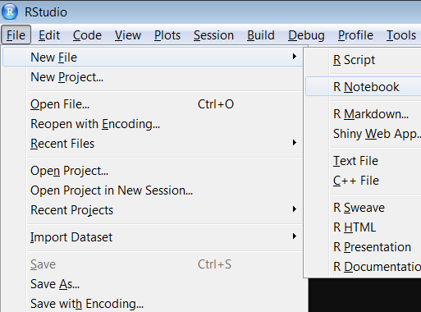
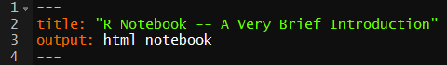
Initialization
When starting a new R Notebook file, select the “R Notebook” file type specifically from the dropdown menu
Alternatively, you can save any file you have open in RStudio as an R Notebook file by saving the file with the file format ending “.rmd”
Common Question: What is with the “--- title output ---” at the beginning of the file?
Answer: This notation allows you to edit the metadata associated with your document. We will go into what you need to know about them on the next slide.

Slide 3
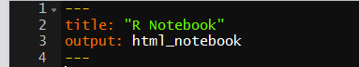
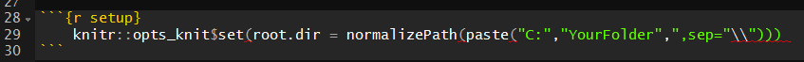
Initialization (Continued)
At the top of your new document, you will encounter the following:
If you’d like to change your working directory at any time in your document, then add the three lines of code at the bottom of this slide before you begin
Replace “YourFolder” with the folder that you would like to connect to
This is an example of a “Chunk”
More on why this step is necessary will be explained in a few slides
These are used to give a title to your document and to dictate your file output type, respectively

Slide 4
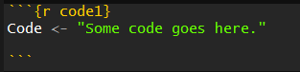
Chunks?
The main benefit of using R Notebooks to present data is the use of what are known as “chunks”
Chunks refer to areas within the document where interpretation of input switches from simple text to code
By default, the command “ctrl-alt-I” inserts a chunk into your document
Chunks can be given names
To name a chunk, replace the {r} at the beginning of the chunk with {r “name”}
Your chunk will now have the name “name”
A chunk appears as follows:
R Notebook provides support for the following languages:
R
Bash
Python
Rcpp
SQL
Stan

Slide 5
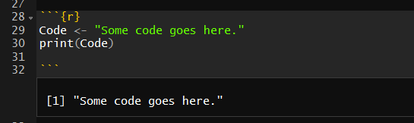
Executing Chunks – Inline
Chunks can essentially be “toggled on and off”, meaning you can either have them execute and display output in real time or not
By default, chunks are displayed “inline”, meaning that the resulting output of executing the code is displayed within the body of your document
Common Question: Is each chunk independent of each other, like how local variables within a function are not available within another function?
Answer: For the most part, no: generally, anything you define above a line in R Notebook is considered to be global, and you can refer to it in a later chunk. The exception to this is altering the working directory; in order for R Notebook to not alter the global working directory for anything outside of it, it by default doesn’t permit chunk assignments to change the working directory any further than the end of the chunk. This can be bypassed however by using the normal chunk syntax but replacing {r} with {r setup} and then executing “knitr::opts_knit…” code shown at the bottom of slide 3. While normal R Notebook files are presumed to be self-contained, the {r setup} creates what is called a “setup chunk”, allowing you to do things like global directory changes and outside function calls

Slide 6
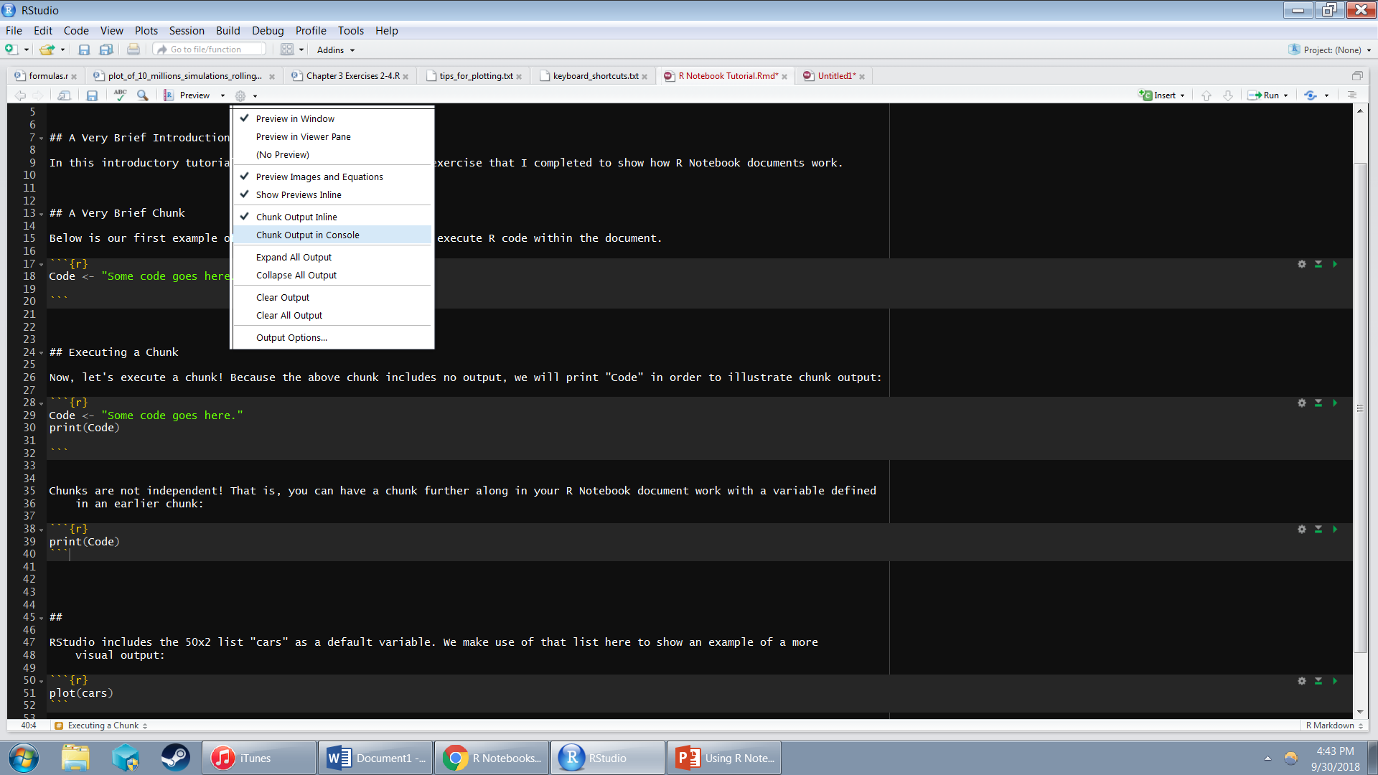
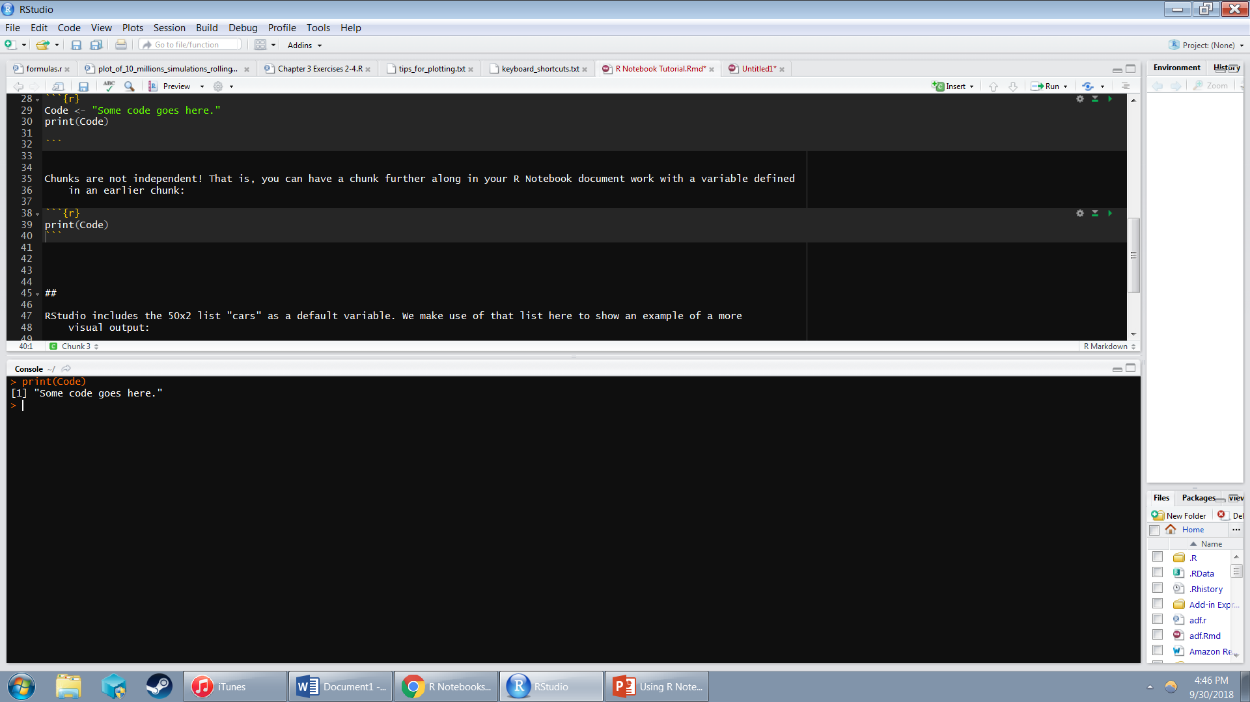
Executing Chunks – In Console
R Notebook also includes the option to present chunk output in the console
To access this, click the small gear icon, , and select “Chunk Output in Console” within the third box

Slide 7
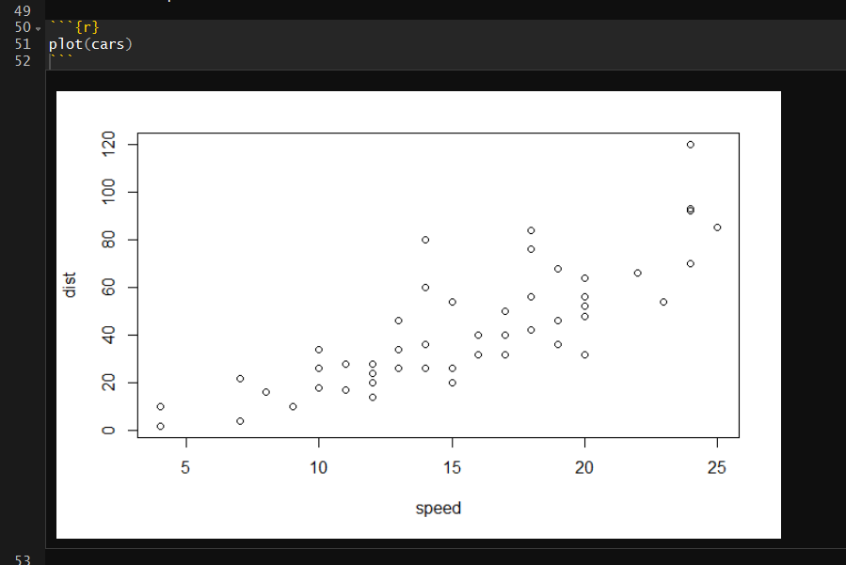
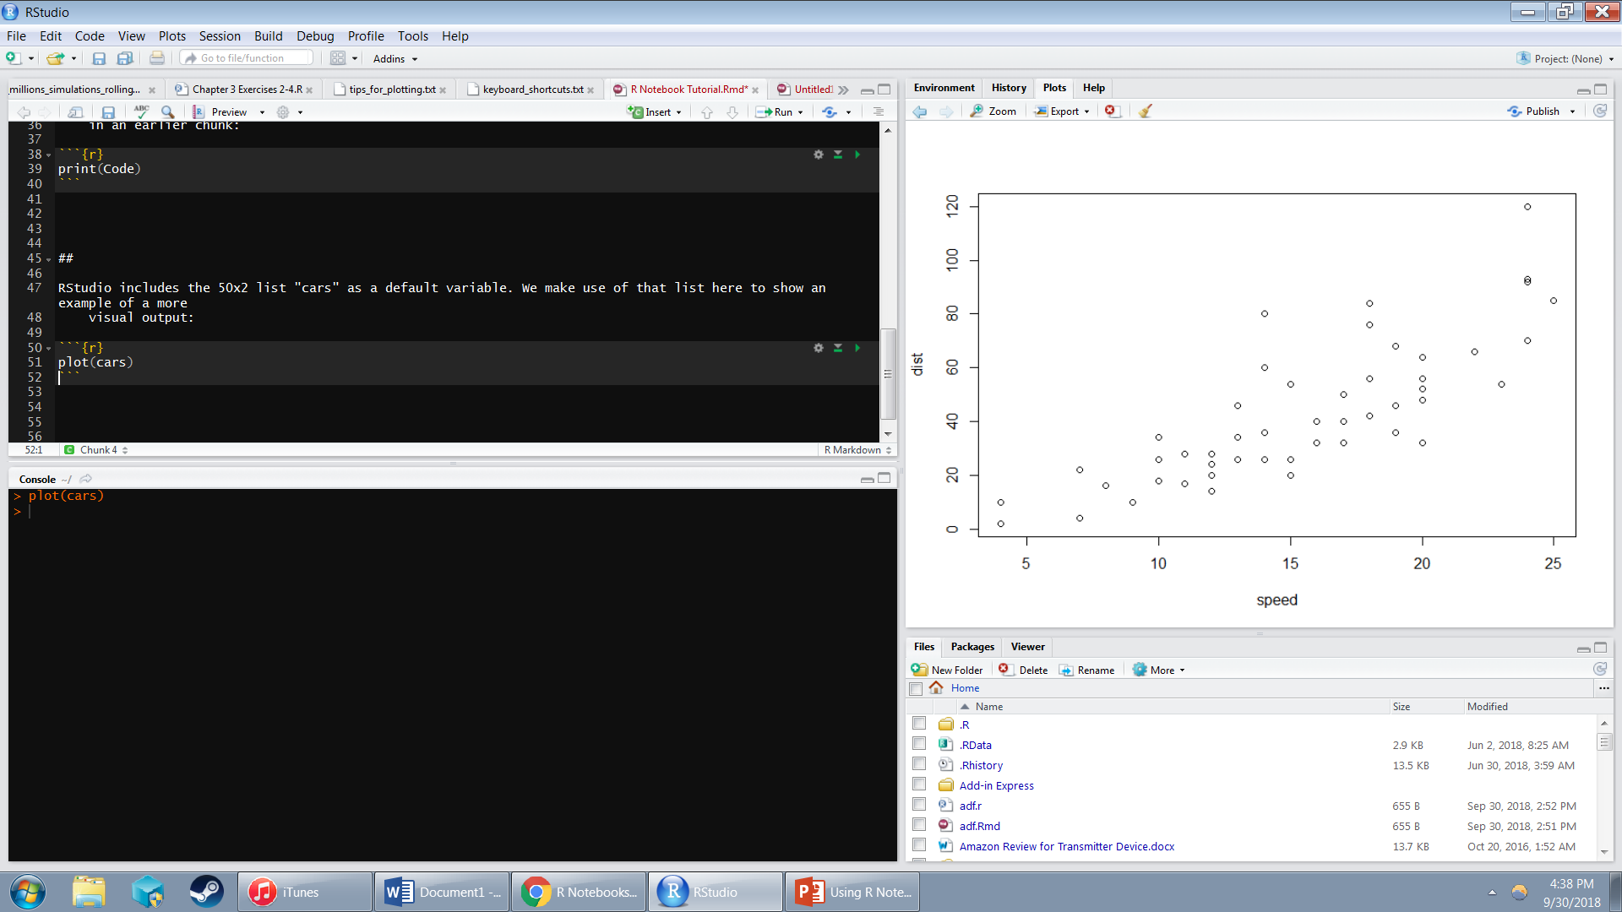
Comparison of “Inline” and “In Console” Output
Inline
In Console

Slide 8
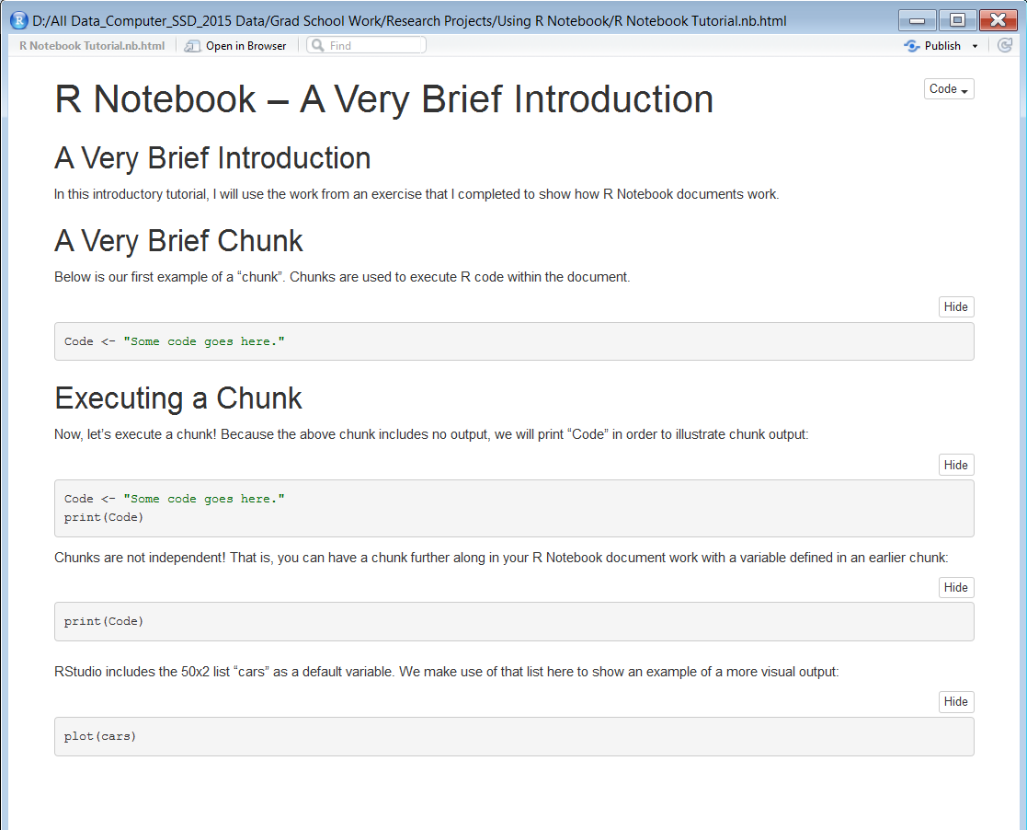
Previewing Output
An R Notebook document can be “previewed” as output, displaying data as a rendered R Markdown document without executing any of your chunks
However, all currently inline-displayed chunks that are showing will appear in the previewed document
The “preview” option is just to the left of the small gear icon displayed earlier
An example of output from an R Notebook document

Slide 9
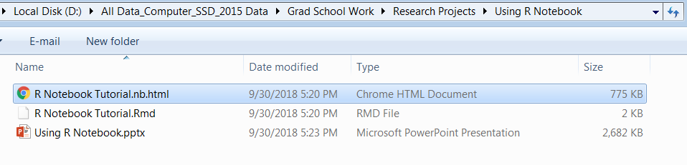
Saving and Additional Concerns
Whenever you save your document, alongside the .rmd file you are currently working on, a .nb.html file is created
This document is simply an html file displaying exactly what clicking “preview” would have done at the time of saving
File formatting within an R Notebook document is done in the markdown formatting language
Markdown is an easy-to-use text formatting language that allows for the creation of rich text using plain text
For more information on formatting using markdown, consult https://daringfireball.net/projects/markdown/basics
This document can be shared with others and opened either within a web browser or within RStudio itself

Slide 10
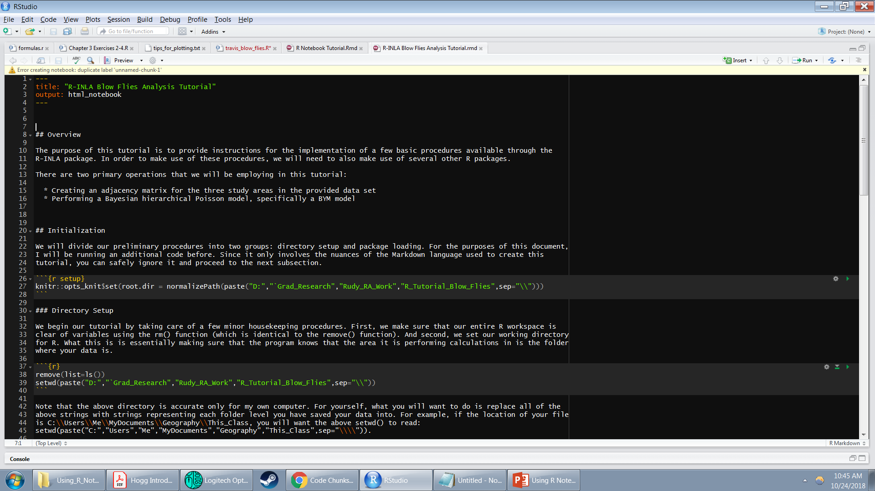
Common Errors
Error: 'is_latex_output' is not an exported object from 'namespace:knitr' Execution halted
Solution: Run the following code in your R console:
install.packages('knitr', repos = c('http://rforge.net', 'http://cran.rstudio.org'), type = 'source')
_
Solution: Give a unique name to all of your unnamed chunks

Slide 11
Credits
This informational presentation was compiled using the helpful guides available on the rmarkdown website as a general guide
https://rmarkdown.rstudio.com/r_notebooks
Ancillary information about R Markdown concepts gathered from the following specific webpages:
https://rmarkdown.rstudio.com/lesson-1.html
https://bookdown.org/yihui/rmarkdown/html-document.html
https://rmarkdown.rstudio.com/articles_intro.html
https://en.wikipedia.org/wiki/Markdown

